Slide 1
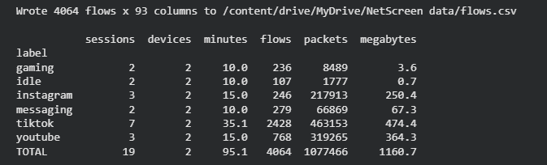
The capture pipeline works end to end
UPDATE 2 · WHAT WE BUILT
01
02
03
04
05
Phones on hotspot
tshark capture
Labels
NFStream
Flow table
iPhone and Samsung, one app for 5 minutes
only that phone’s IP, saved as .pcapng
app, phone and time for every session
packets grouped into two-way flows
93 features per flow, analysed in Colab
Problems we hit, and how we fixed them
Our Colab run on all 19 recordings
Capture driver would not install
A leftover from an old VMware install blocked Npcap. We removed it and capture works.
Hotspot capped at 1–2 Mbit/s
Through a slow link every app looks alike. A hotspot restart brought it to 15–20 Mbit/s.
A VPN was still running
Output of features/extract.py, unedited
Cloudflare WARP tunnelled our “plain” traffic. We turned it off and re-recorded those sessions.
Notes:
~1 min. Since the first update we built the whole capture side. Phones join a laptop hotspot, so all their traffic goes through the laptop. tshark records only one phone’s IP address, so each recording is one phone and one app for five minutes, with a label row saying which app, which phone and when. NFStream then groups the packets into two-way flows and computes 93 features per flow, packet sizes, timing and the first 20 packets, and we analyse that table in Colab. On the right is the real output of that run over all 19 recordings. Getting here we hit three problems that would have ruined the data without us noticing. The capture driver would not install because of an old VMware leftover. The hotspot was capped at 1 to 2 megabits, and at that speed every app looks the same. And a VPN, Cloudflare WARP, was still running on the laptop, so part of our plain traffic was tunnelled. We fixed all three and re-recorded the affected sessions.

Slide 2
Each app leaves its own traffic shape
UPDATE 2 · FIRST LABELED DATASET
19
2 phones
4,064
1.08 M
5-minute sessions, 95 min
iPhone and Samsung, 6 apps
flows extracted
packets, 1.16 GB
Both charts: the 17 sessions recorded under normal conditions. The 2 sessions recorded with a VPN on are left out.
Video and social: ~1 KB packets at 1–5 Mbit/s. Gaming and idle: under 0.5 KB at 0.06 Mbit/s or less.
Next, Nov 19: DNS and SNI baselines, Random Forest and XGBoost, more gaming, idle and messaging sessions.
Notes:
~1 min. This is our first labeled dataset: 19 five-minute sessions from two phones, an iPhone and a Samsung, across six apps, which gave about four thousand flows and a million packets. Two of the iPhone sessions were recorded while the VPN was still on, so the charts use the other 17. Two things stand out before we train anything. First, the same app looks alike on both phones: TikTok is about one kilobyte per packet and just under 2 megabits per second on both. Second, the apps are far apart from each other: video and social apps send full-size packets at one to five megabits, while a game or an idle phone sends small packets at a hundredth of that. That gap is exactly what our classifier will learn from. Not everything matches across phones: YouTube on the Samsung streams at twice the rate, so later we will also train on one phone and test on the other. Next, by November 19: the DNS and SNI baselines, Random Forest and XGBoost, and more sessions for the apps we have only two of.

